Slide 1
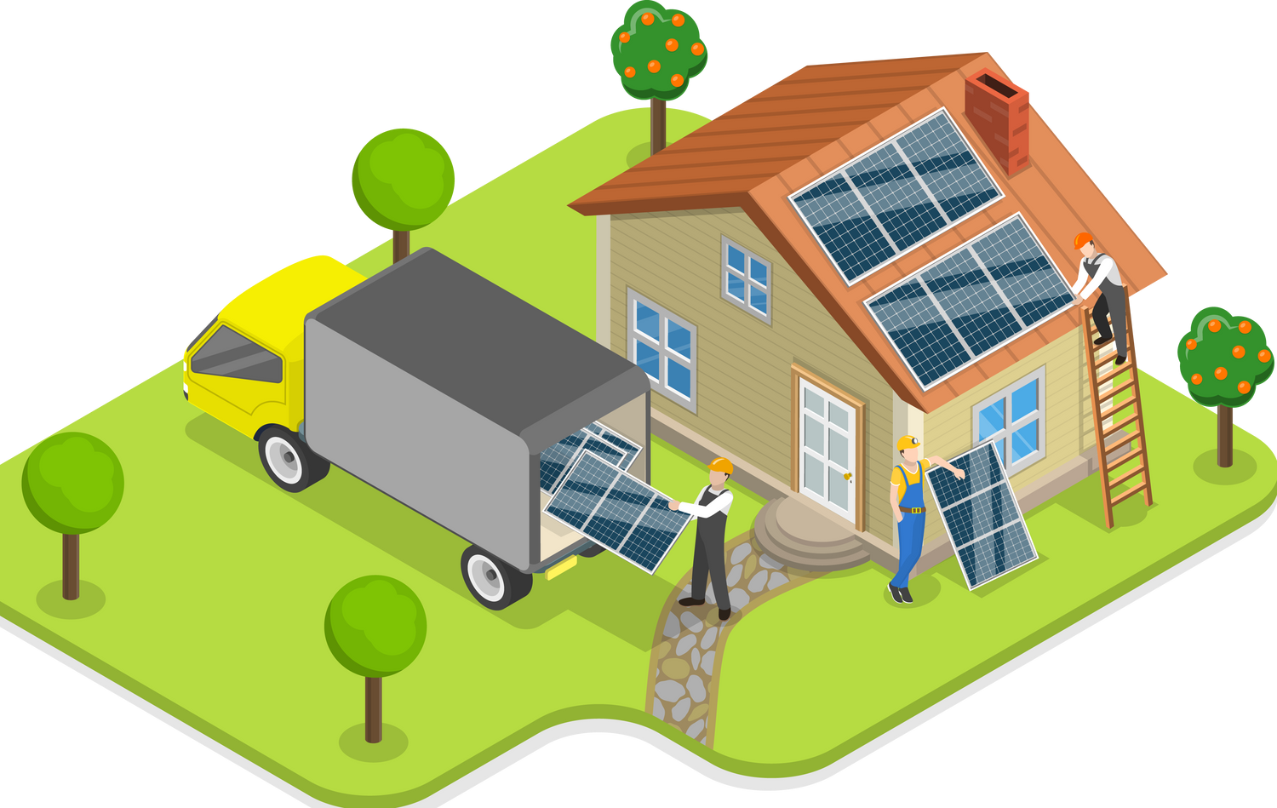

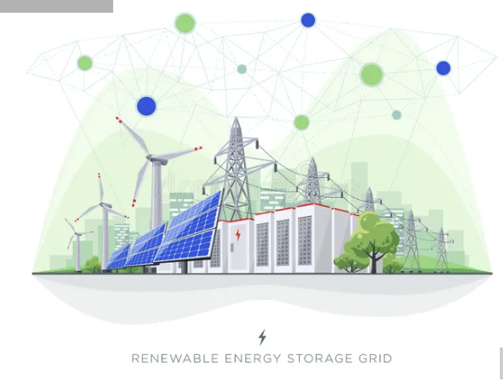
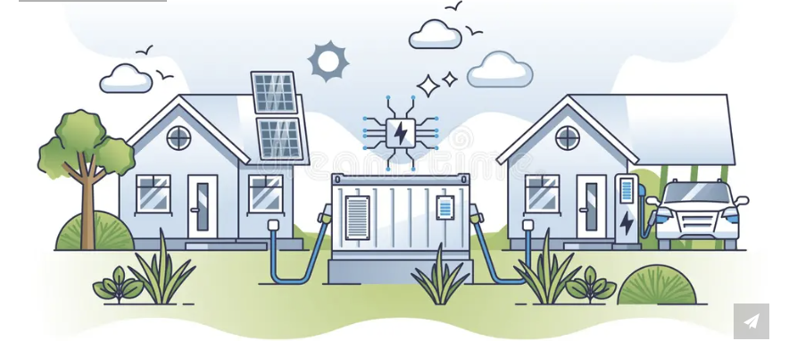
The Microgrid Optimizer
Theme:
Sustainable Energy
“Empowering communities through intelligent energy sharing”

Slide 2
Executive Summary
SmartGrid+ is a decentralized, intelligent power management system that enables peer-to-peer energy sharing between homes and communities to optimize renewable energy usage. Each home functions as both an energy producer and consumer, dynamically balancing its own demand and supply through local energy storage.
At the neighborhood level, Local Area Networks (LANs) allow homes to share surplus power or request additional energy collaboratively. These LANs connect to Metropolitan Area Networks (MANs), which use AI-driven forecasting to predict future energy demand and supply patterns.
By reducing dependence on fossil fuels and maximizing renewable utilization, SmartGrid+ creates a cleaner, more efficient, and resilient energy ecosystem adaptable to both urban and rural contexts.
Key Outcomes
30–40% improvement in renewable energy utilization
Predictive, demand-aware coal generation control
Scalable and adaptive model for urban and rural microgrids

Slide 3
Challenges
In the current system, a home equipped with solar panels generates power during the day, consumes a portion of it, and sends the surplus to the grid at a low return value. Later in the evening, when demand peaks and renewable generation drops, the same household faces shortages. To meet this sudden demand, the central grid activates coal-based power plants, leading to increased carbon emissions and higher dependency on non-renewable sources.
1.Renewable energy often goes unused when production exceeds demand.
2.Fossil fuels are still relied on during short-term imbalances.
3.Households have no real-time way to share or balance energy locally.

Slide 4
Problem Statement
Context of the Problem
Despite the rapid growth of renewable energy, power distribution remains highly inefficient. Excess renewable power generated by one home or region often goes unused, while nearby homes face energy shortages. The traditional centralized grid is unable to adapt effectively to the fluctuating nature of solar and wind energy, leading to persistent fossil fuel dependence, higher emissions, and significant energy losses.
Who It Affects
This problem impacts urban and semi-urban households with rooftop solar panels, communities in developing regions that experience frequent power cuts, and power utilities struggling to manage inconsistent renewable inputs.
User Persona
Ananya, a homeowner in Bengaluru with rooftop solar panels, often produces more energy than her family consumes during sunny days. However, the surplus power either goes to waste or is sold to the grid at low rates. Meanwhile, her neighbor experiences blackouts later that evening. Despite the availability of clean energy, both households continue to rely heavily on coal-based grid power.
Market Size
Globally, over 1.5 billion households use electricity, and more than 250 million homes are expected to have solar installations by 2030. The distributed energy systems market, which supports this transition, is already valued at over $300 billion worldwide, highlighting the vast potential for scalable, intelligent energy-sharing solutions like SmartGrid+.

Slide 5
Research and Key Insights
Current renewable energy systems face several structural inefficiencies. Net metering enables homeowners to sell excess solar energy back to the grid, but the process is one-directional and inefficient, offering minimal returns. Battery storage solutions exist but operate in isolation, preventing energy sharing between households. While modern smart grids enhance monitoring and management, they remain largely centralized and lack adaptive intelligence. Virtual power plants provide large-scale coordination but are costly and typically limited to major utilities.
Research indicates that true sustainability depends on localized energy balancing and real-time prediction. Artificial Intelligence can forecast short-term renewable fluctuations, reducing the need for fossil fuel backup. Community-level coordination through localized networks (LANs) has the potential to cut renewable energy wastage by as much as 30–40%, making the system far more efficient and resilient.

Slide 6
Proposed Idea – Overview
SmartGrid+ creates a multi-layered decentralized energy sharing network powered by AI-based forecasting and local collaboration.
How It Works
Individual Household: Uses AI-driven prediction and smart meters to optimize self-consumption and share surplus energy.
Local Area Network (LAN): Connects nearby homes to enable peer-to-peer energy exchange and local load balancing.
Metropolitan Area Network (MAN): Integrates multiple LANs to coordinate with power stations and stabilize regional energy flow.

Slide 7
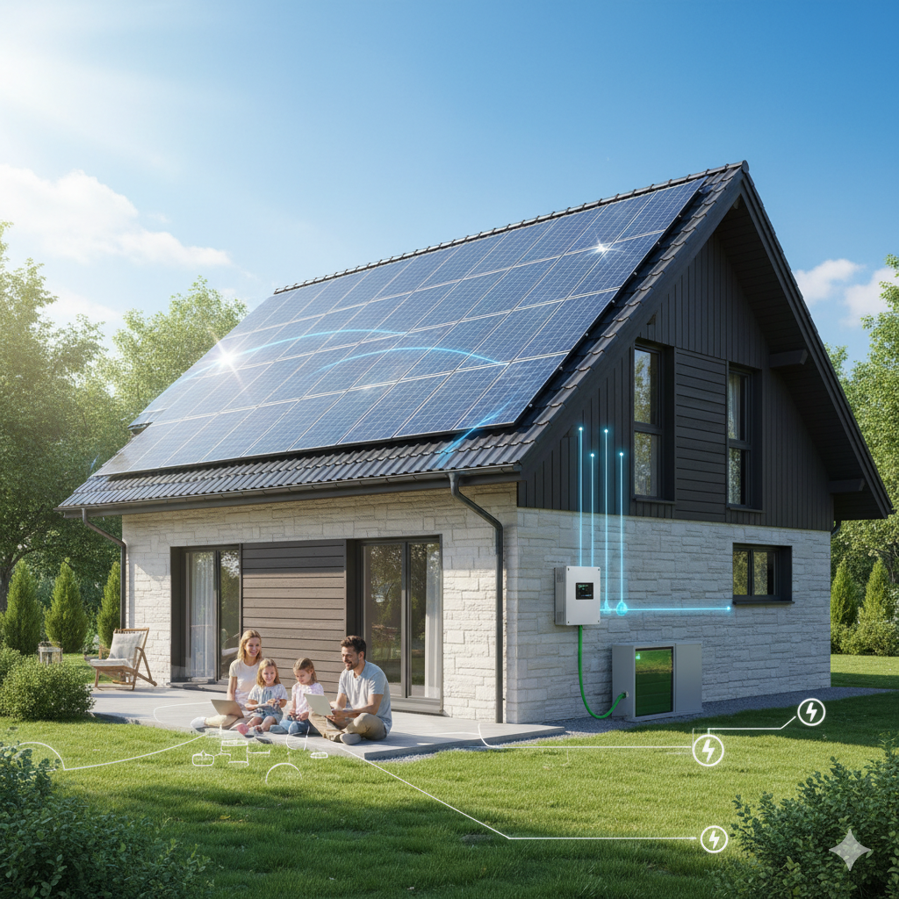
Consumer Level
Proposed Idea – Overview
Each house in the system continuously calculates its energy requirement by comparing its demand with its current production. When production exceeds demand, the surplus energy is stored locally. If production falls short, the home first draws power from its own storage. When the storage nears depletion, the home sends a request for additional energy to the local network (LAN). Conversely, if the storage exceeds its capacity, the extra energy is automatically transferred to the LAN so that other homes can utilize it.

Slide 8
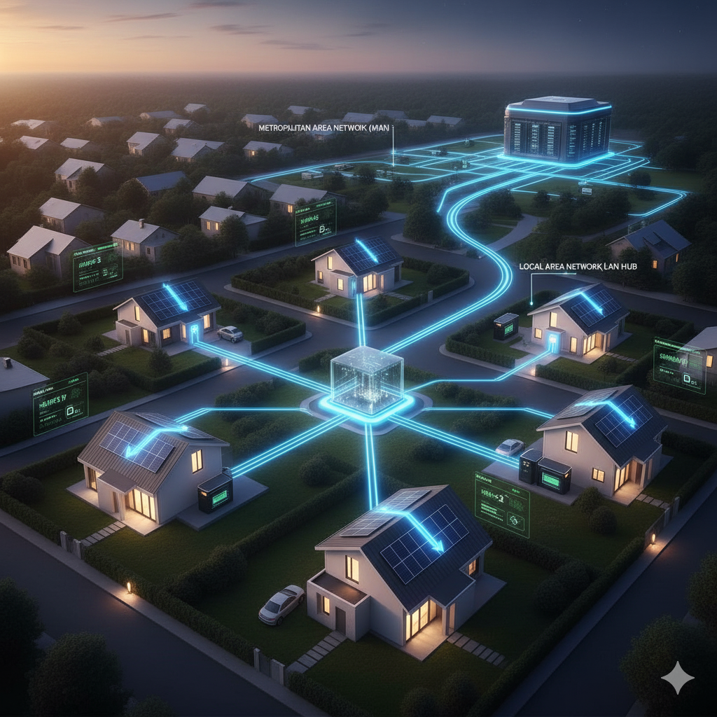
LAN
Proposed Idea – Overview
The LAN acts as a neighborhood-level energy manager. It aggregates data from all connected homes, balancing supply and demand within the community. Only when the combined neighborhood storage and production are insufficient does the LAN request additional power from the Metropolitan Area Network (MAN).

Slide 9
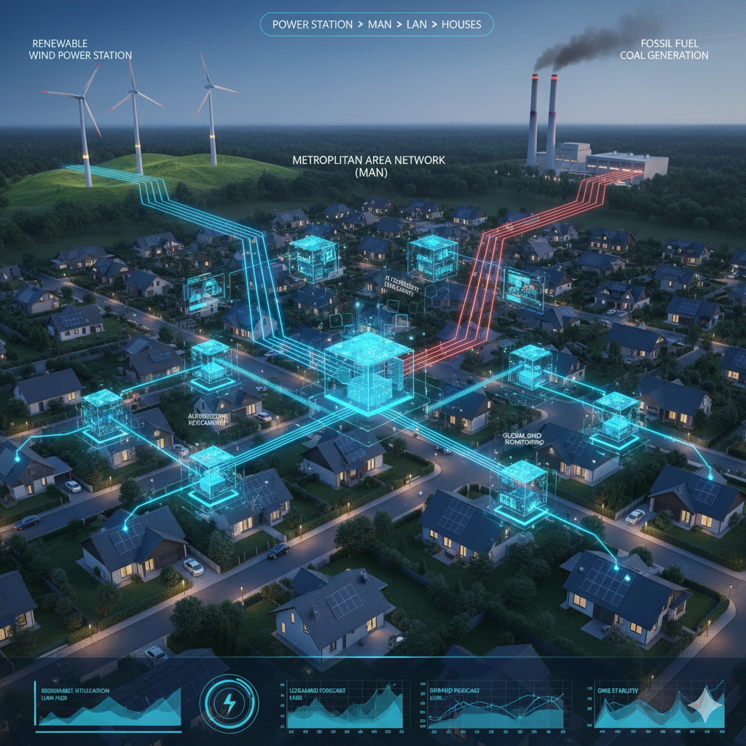
MAN
Proposed Idea – Overview
The MAN oversees multiple LANs and integrates real-time data from renewable sources such as solar and wind. Using AI-based forecasting, it predicts both energy demand and supply for the next 30 minutes. Based on these predictions, the MAN triggers coal-based generation only when required, operating it at the forecasted rate with an additional 20% buffer to ensure grid stability. This intelligent coordination ensures that renewable energy is always prioritized, while fossil fuel usage is minimized to maintain a sustainable and resilient power system.

Slide 10
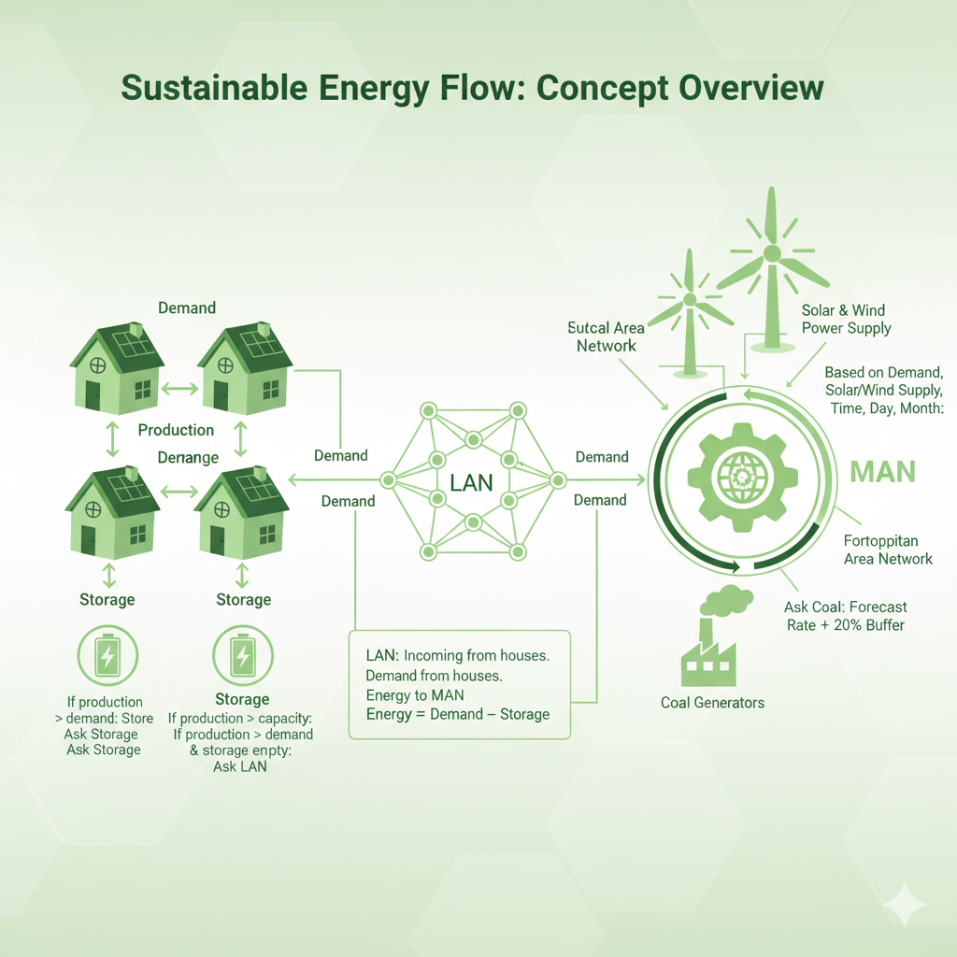

Slide 11
Proposed Idea –
Innovation and Creativity
The proposed system combines AI forecasting, IoT-enabled smart meters, and decentralized energy trading into a single, scalable framework. In this model, individual homes function as intelligent, independent nodes that dynamically share energy with one another based on real-time needs and availability. The system introduces a multi-tiered hierarchy—Home to LAN to MAN to Grid—that mimics the behavior of a neural network, continuously learning from and adapting to evolving energy consumption and production patterns.
By merging principles from electrical engineering, data science, and climate systems, the design creates a practical, efficient, and eco-friendly approach to energy management. Unlike conventional grid systems that rely primarily on centralized monitoring, SmartGrid+ emphasizes localized intelligence and predictive decision-making, ensuring a more resilient and adaptive energy ecosystem.

Slide 12
Proposed Idea –
Implementation Plan
Deployment Phases and Implementation Plan
The project will be executed in multiple phases to ensure smooth development and scalability. Phase 1 focuses on creating a simulation prototype that visualizes energy flow between LANs and MANs—this will serve as the primary deliverable for the hackathon. In Phase 2, IoT-enabled smart meters will be integrated to collect realtime data on energy production, consumption, and storage. Phase 3 involves a pilot implementation within a single LAN comprising 10–20 homes to test real-world performance. Finally, Phase 4 scales the system to include multiple LANs, incorporating AI-based forecasting and optimized coal-based energy generation to maintain efficiency and stability.
Resources Required
To support deployment, the project will require technical resources such as IoT sensors, machine learning models, and cloud-based infrastructure for data processing and visualization. Collaboration with local energy utilities, solar power providers, and government sustainability programs will be essential. Additionally, expertise from electrical engineers, data scientists, and environmental specialists will ensure a robust and multidisciplinary foundation.

Slide 13
Proposed Idea –
Implementation Plan
Potential Risks and Mitigation
Potential risks include data inaccuracies, which will be mitigated through real-time IoT feedback loops that continuously refine predictions. User adoption challenges may arise, so the system will feature an intuitive interface and demonstrate visible cost benefits to encourage participation. Financial constraints will be addressed by seeking green energy grants and forming public–private partnerships to share implementation costs.
Proof of Concept and Estimated Costs
As a proof of concept, a working simulation and interactive dashboard will be developed to demonstrate various scenarios of energy production, consumption, and sharing across LANs and MANs. The estimated cost for the pilot phase is approximately ₹25,000–₹30,000 per household for the installation of smart meters and control systems. In the long term, the system is expected to reduce electricity bills by 20–25% while significantly lowering carbon emissions, contributing to a cleaner and more sustainable energy ecosystem.

Slide 14
Proposed Idea –
Impact
Expected Outcomes and Impact
SmartGrid+ will cut fossil fuel reliance by 30–40% and boost renewable energy efficiency by 20–25%. By balancing local generation and demand, it reduces grid stress, lowers outages, and enhances overall energy reliability.
Who Benefits
Households gain reliable, cheaper power; utilities enjoy smoother load management and lower infrastructure strain; and governments move closer to emission and sustainability targets.
Impact Measurement
IoT sensors and smart meters will continuously track performance. AI dashboards will analyze renewable use, storage, and flow, providing real-time insights into efficiency and sustainability gains.
Inclusivity and Equity
SmartGrid+ ensures even non-solar homes benefit through shared clean energy in the LAN. It encourages collaboration, equal access, and community participation in the clean energy ecosystem.
Indirect Benefits
The system promotes faster solar and smart-home adoption, generates green jobs in IoT and data analytics, and strengthens climate awareness and community resilience.

Slide 15
Proposed Idea –
Scalability Plan
Scaling and Sustainability Plan
The project will begin with small-scale urban neighborhoods and gradually expand to semi-urban and rural regions using modular LAN–MAN structures. Forecasting models will be customized to suit diverse climates and geographic conditions, ensuring adaptability and accuracy across different regions.
Over time, the initial investment will decrease as infrastructure is shared and system efficiency improves, making the model more cost-effective and sustainable.
Funding in the early stages will rely on climate innovation and sustainability grants, while later phases will be supported through partnerships with power utilities and subscription-based participation models.
The initiative aligns with UN Sustainable Development Goals 7 (Clean Energy) and 13 (Climate Action) and supports India’s National Solar Mission and broader global carbon neutrality targets.
In the long term, SmartGrid+ will establish a resilient and eco-friendly energy network that lowers carbon emissions and strengthens communities’ ability to adapt to future energy challenges.

Slide 16
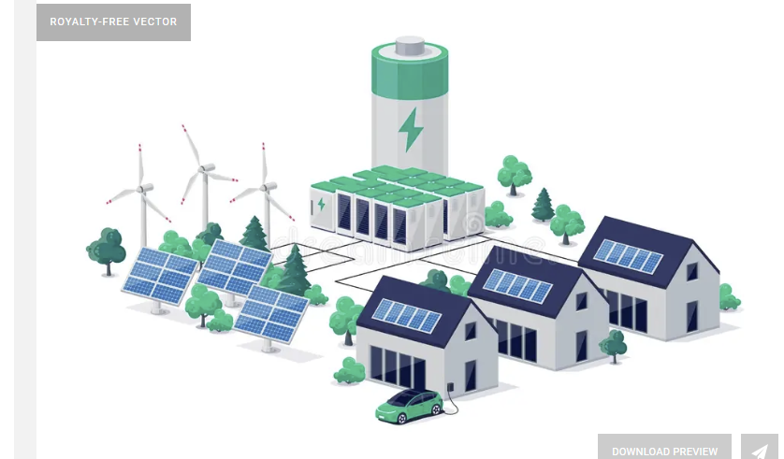



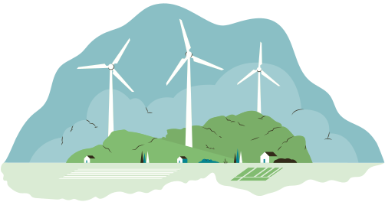
Thank You!

